Slide 1


Single layer feed back networks-basic concepts
=============================================================================
WWW.THEMLLABS.COM || contact@themllabs.com || Phone : 91-7338339898, 91-6362546088

Slide 2
Agenda
Single layer feed back networks
=============================================================================
WWW.THEMLLABS.COM || contact@themllabs.com || Phone : 91-7338339898, 91-6362546088

Slide 3
Single layer feed back networks
In single layer networks there is only two layers, input and output layer, input layer doesn’t count (there is no computation in the layer).
When the output of the layer directed back as input to the same layer then it is called feed back networks.
The input layer can get the inputs from the output layer.
=============================================================================
WWW.THEMLLABS.COM || contact@themllabs.com || Phone : 91-7338339898, 91-6362546088

Slide 4
In feed back networks, signals travel in both directions.
These networks are very powerful, complex and dynamic.
The state of the networks is keep changing, until they reach an equilibrium point.
Feed back neural network architecture is also referred to as recurrent or interactive
=============================================================================
WWW.THEMLLABS.COM || contact@themllabs.com || Phone : 91-7338339898, 91-6362546088

Slide 5
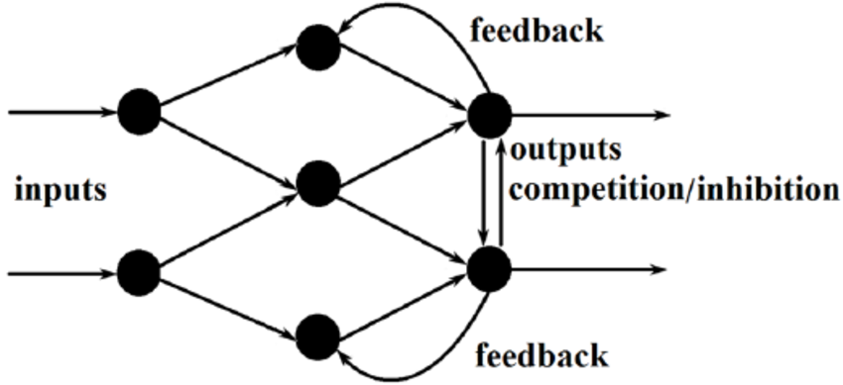
These networks allow feedback loops.
They are used in addressable memories
=============================================================================
WWW.THEMLLABS.COM || contact@themllabs.com || Phone : 91-7338339898, 91-6362546088

Slide 6
Thank you
=============================================================================
WWW.THEMLLABS.COM || contact@themllabs.com || Phone : 91-7338339898, 91-6362546088

